Slide 1


Data Visualization Project - 1
Data Source:
City of Chicago Crime Data 2001-Present
Deanna Badong Kevin Grzyb Sebastian James Olu Saibu

Slide 2
Data Observations:
Data requires fill of NaN fields
2019 Data reflect Year to Date Data (YTD) – Collected as of 30 September 2019, ¾ of full year data
2001 Starting Year Data Incomplete
We did not research changes to laws or ward gerrymandering over time

Slide 3
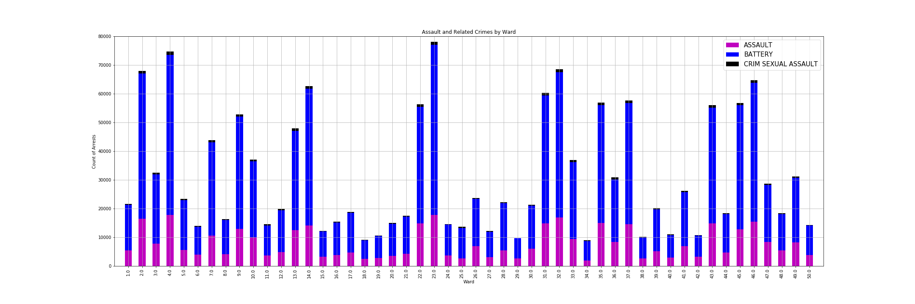
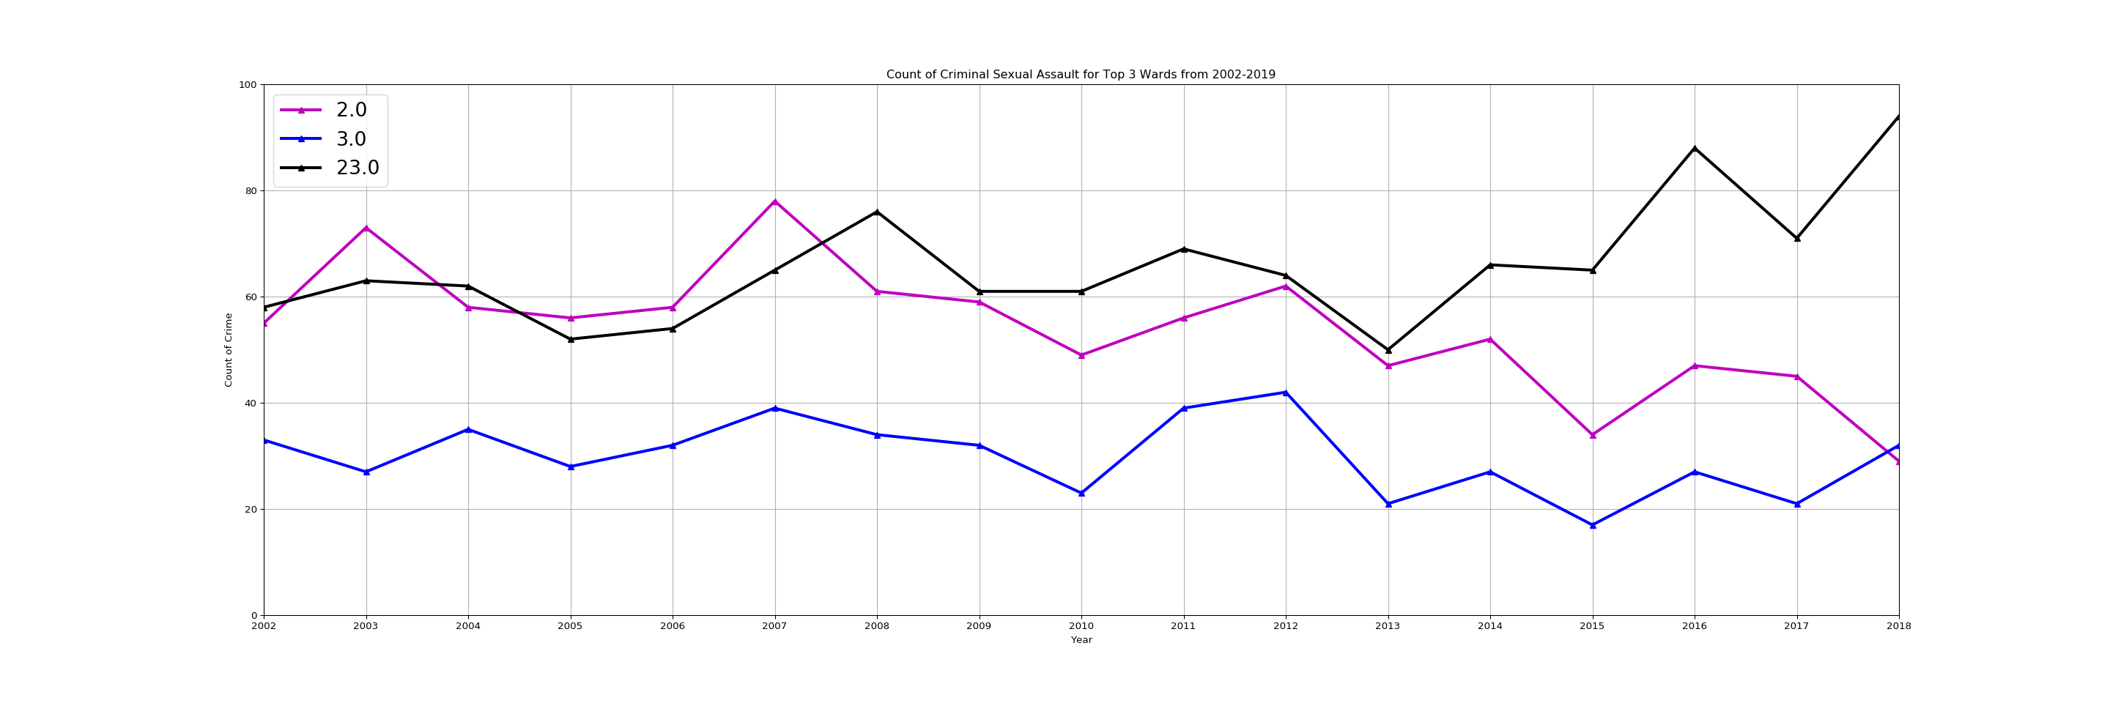

Slide 4
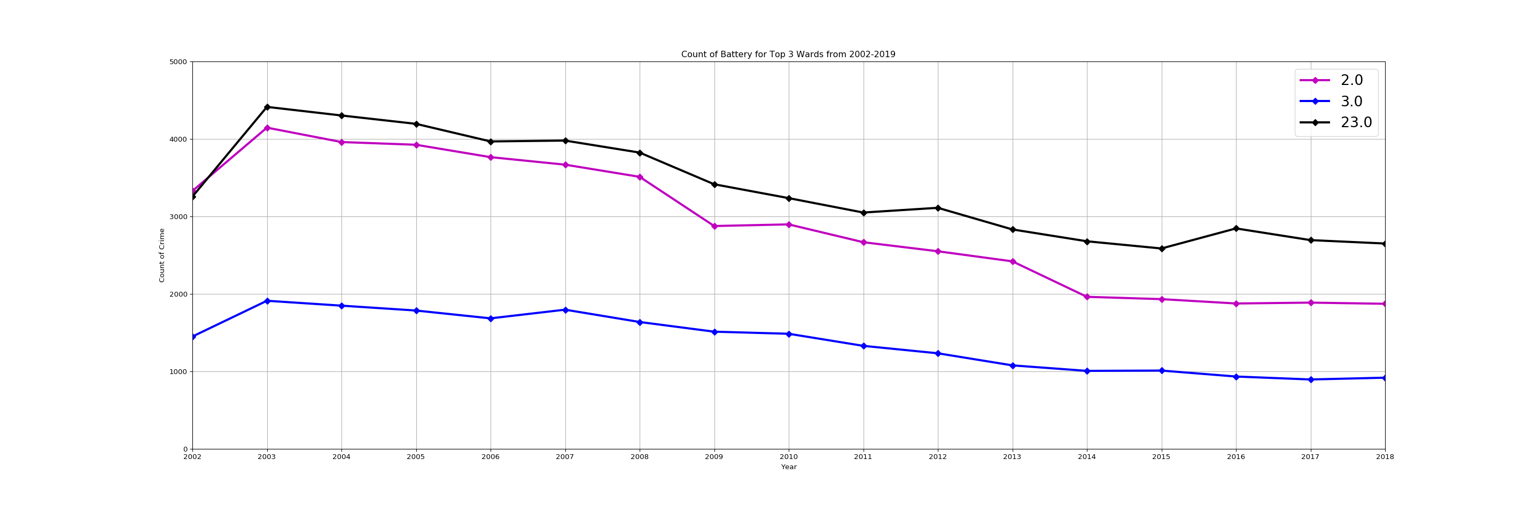
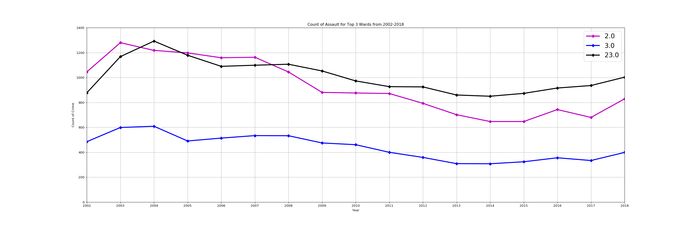

Slide 5
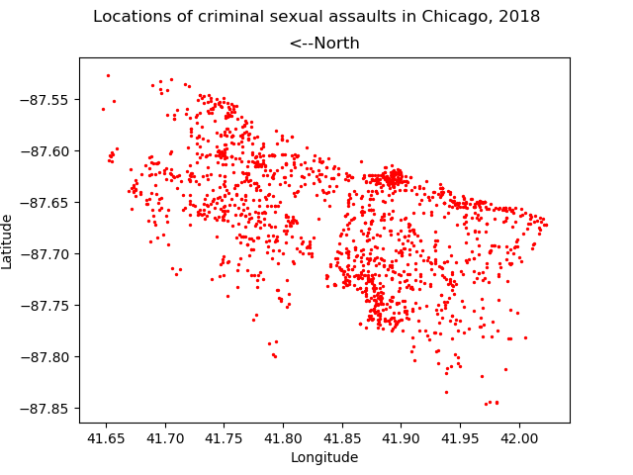

Slide 6
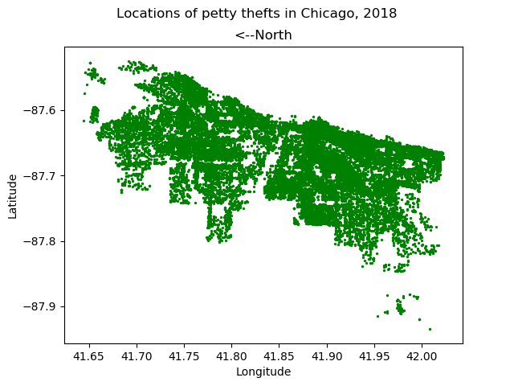

Slide 7
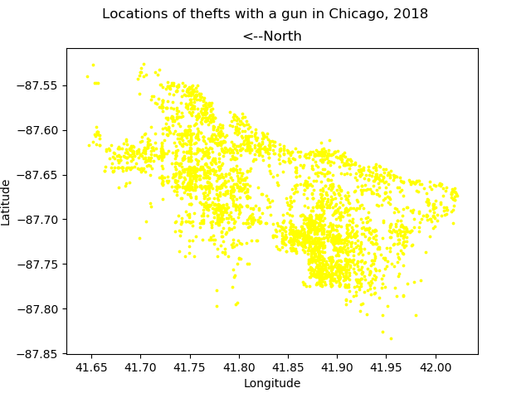

Slide 8
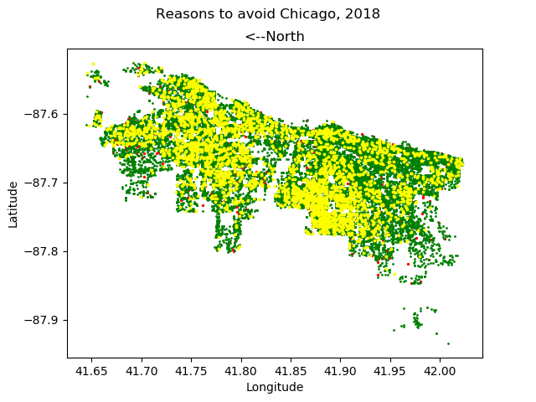

Slide 11
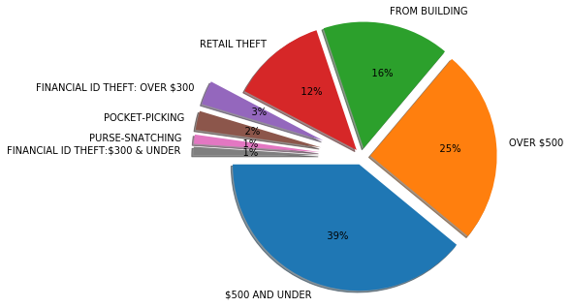

Slide 12
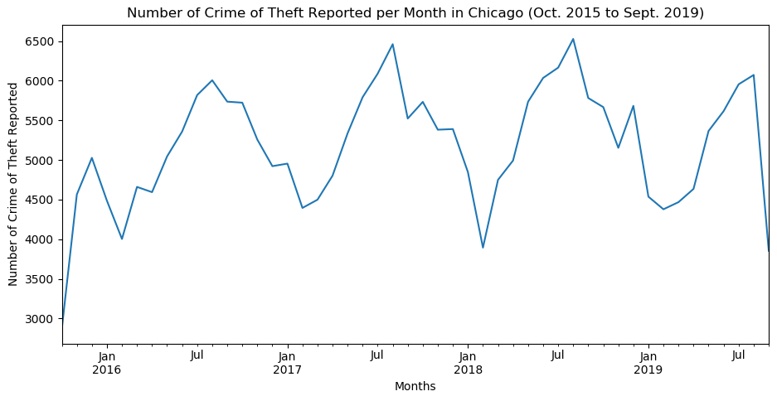

Slide 13
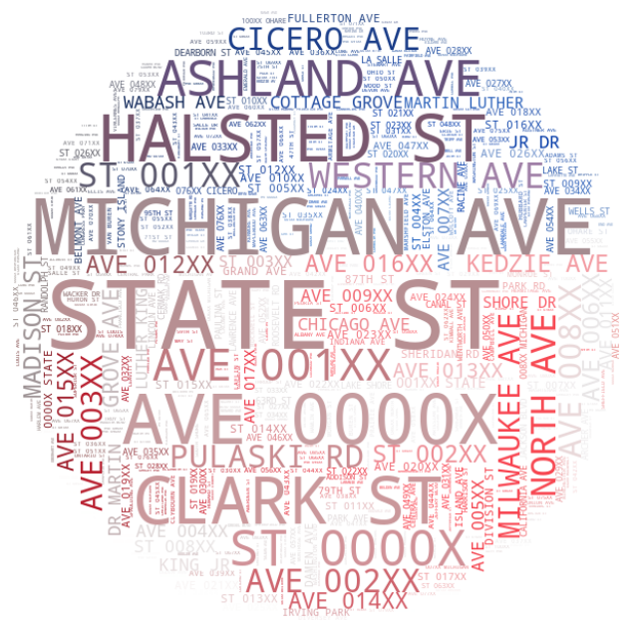

Slide 14
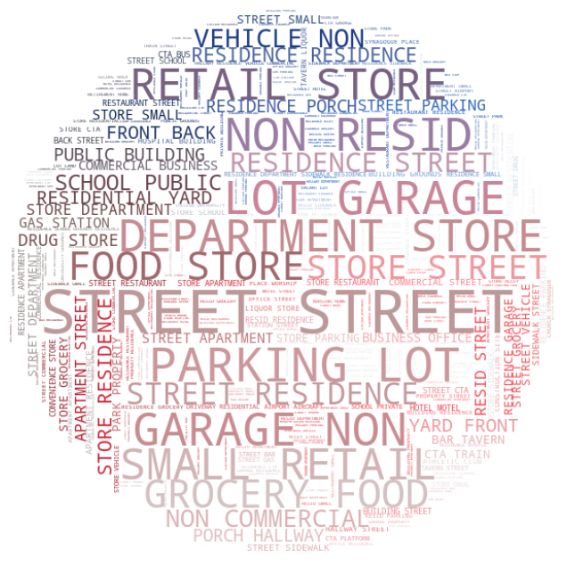

Slide 15
